Slide 1

SUBJECT: SPOTIFY CLONE
PBL PROJECT-II
BCA – 4TH SEM
DIV-N
GROUP NO -(218)
INTERNAL FECULTY GIUDE
Prof .DIMPLE SHAH
(SOCCA)

Slide 2
CENDIDATE’S DECLARATION
SUTHAR SANJAYKUMAR AMARARAM : 2204030101400
PANCHAL HARSH PRAKASHCHANDRA : 2204030100720
SURAJ KUMAR GUPTA : 2204030101389
THAKKAR HARSH KUMAR JAYESHBHAI : 2204030101421
KUSHVAH MITESH HARGYANSING : 2204030100563

Slide 3
Table of Content
Introduction
Abstract
Objectives
Why you have selected this topic?
Worked carried out till date
Screenshots
Future Work
References
6/25/2018

Slide 4
Introduction
Welcome to the world of audio streaming innovation! In this Spotify clone project, we embark on a journey to recreate the magic of one of the most popular music platforms. Our goal is to develop a user-friendly application that seamlessly delivers an immersive music experience, mirroring the features and functionality of Spotify. Get ready to dive into the realm of coding melodies and creating a harmonious user interface that resonates with the spirit of modern music streaming. Let the coding playlist begin! 🎶

Slide 5
Abstract
Project aims to create a web application inspired by the user-friendly design and functionality of Spotify. This clone will provide a seamless and immersive music streaming experience, allowing users to discover, create, and share playlists effortlessly. The project will utilize modern web technologies to replicate key features such as personalized recommendations, a vast music library, and a dynamic user interface. With an emphasis on responsive design and user engagement, HarmonyHub aspires to deliver a compelling alternative to existing music streaming platforms while adhering to ethical considerations and copyright compliance.

Slide 6
Objectives
The objective of a Spotify Clone web project is to create a music streaming platform that replicates the features and functionalities of the popular music service, Spotify
.A Spotify clone typically offers users the ability to:
Stream a vast library of music
Create playlists
Follow other users
Share their favorite songs and tracks on social channels with their friends and family
Enjoy a personalized music experience
By creating a Spotify clone, you can customize the platform to your liking, add new features, and even monetize it in the future.

Slide 7
Worked carried out till date
As of 8 march, our team has made significant progress in the development of “SPOTIFY CLONE." Key accomplishments and milestones include:
1. Project Initiation
2. Research and Planning
3. Design and Prototyping
4. Backend & frontend Development
5. Project Presentation Preparation

Slide 8
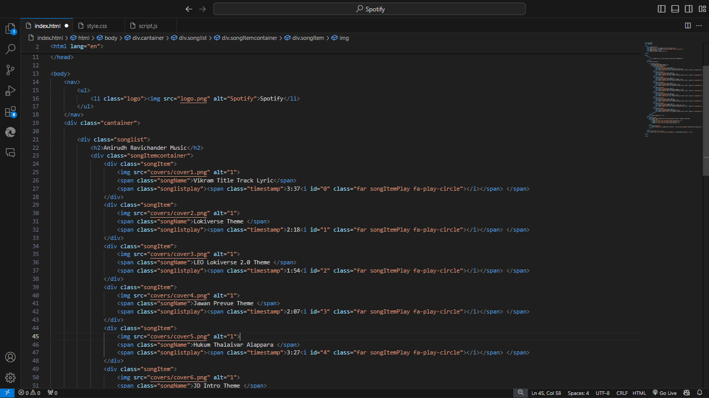
Screenshots

Slide 9
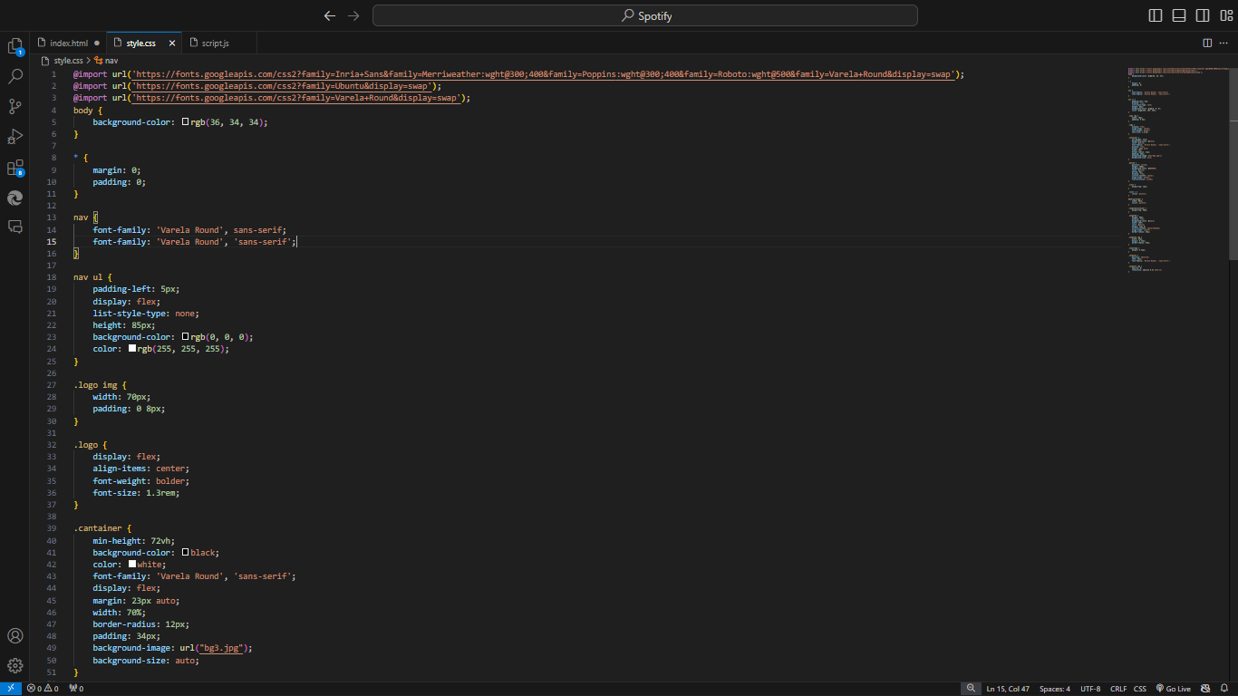

Slide 10
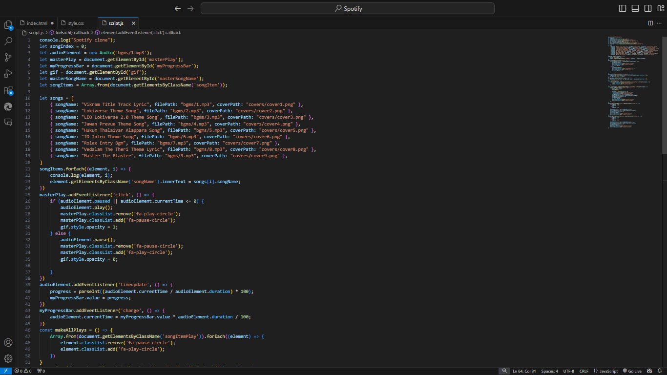

Slide 11
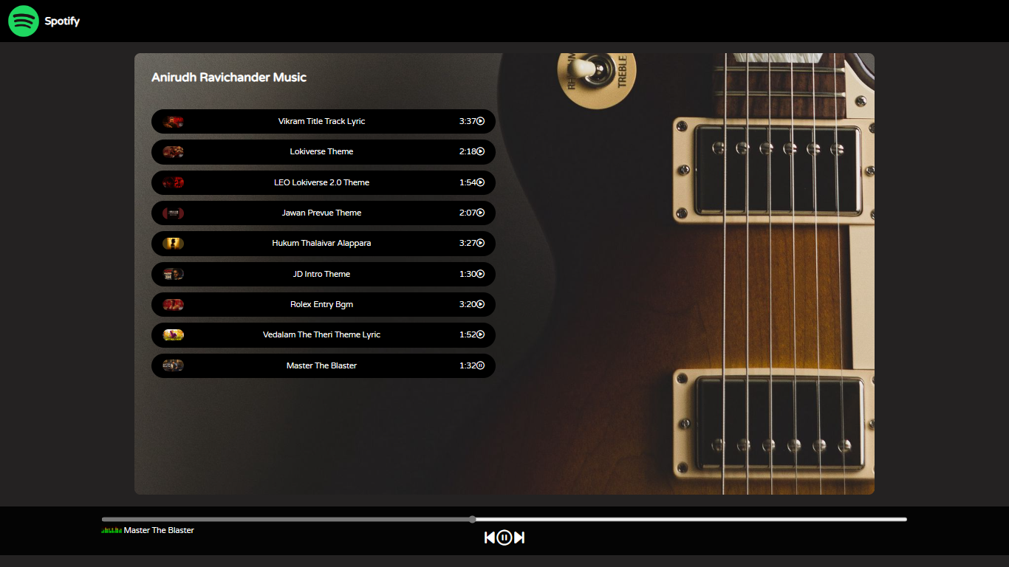

Slide 12
Future Work
Mobile Application
Enhanced Features
Collaborative Features

Slide 13
References

Slide 14
Thank You..!

